Slide 1
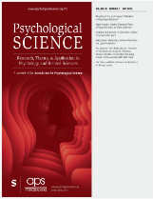
Prosody and Function Words Cue the Acquisition of Word Meanings in 18-Month-Old Infants
Group Member (in no particular order) : Jieping Duan (029), Runqi Qian (030)
Mingjie Du (031), Tingting Yang (033)
Alex de Carvalho, Angela Xiaoxue He, Jeffrey Lidz & Anne Christophe. (2019). Prosody and Function Words Cue the Acquisition of Word Meanings in 18-Month-Old Infants. Psychological Science, 30(3), 319-332.

Slide 2
Division of labor
Leader | Runqi Qian
Group Member | Jieping Duan, Mingjie Du, Tingting Yang
Division of labor
Data Analysis | Runqi Qian 30%, Jieping Duan 20%, Mingjie Du 25%, Tingting Yang 25% | PPT Make | Runqi Qian 15%, Jieping Duan 55%, Mingjie Du 5%, Tingting Yang 25%
Text Report Production | Runqi Qian 25%, Jieping Duan 25%, Mingjie Du 25%, Tingting Yang 25% | PPT Presentation | Runqi Qian

Slide 3
CONTENTS
Introduction
Methods
Reproduction
Novel Analytical Approach
Discussion
Conclusion

Slide 4

Part 1
Introduction

Slide 5
Introduction
Syntactic structure is a key clue for children to infer the meaning of new words (Gleitman, 1990). However, the construction of syntactic structure itself depends on more fundamental linguistic information. Phrase prosody (the rhythm and melody of language) is perceived by infants from birth and helps them identify phrase boundaries in early childhood (Mehler et al., 1988; Männel & Friederici, 2009).
Meanwhile, function words/morphemes, due to their high frequency and unique characteristics, are acquired within the first year of life and used by infants for lexical categorization between 1 and 2 years of age (Gervain et al., 2008; Shi et al., 1998; Cauvet et al., 2014).
However, in reality, not all lexical words are accompanied by explicit function word cues (e.g., the ambiguity of “flies”). At this stage, infants must integrate additional information such as syntactic components for parsing. Thus, phrase prosody and function words/morphemes together form the key foundation for infants to construct basic syntactic structure representations (Christophe et al., 2008, 2016).
Notes:
句法结构是儿童推测新词意义的关键线索（Gleitman, 1990）。然而，构建句法结构本身依赖于更基础的语言信息。短语韵律（语言的节奏与旋律）在出生起就被婴儿感知，并在早期帮助他们识别短语边界（Mehler et al., 1988; Männel & Friederici, 2009）。同时，虚词/语素因其高频和独特的特征，在一岁内即被习得，并在1-2岁时被婴儿用于实词分类（Gervain et al., 2008; Shi et al., 1998; Cauvet et al., 2014）。然而，现实中并非所有实词都伴随明确的虚词线索（如“flies”的歧义性）。此时，婴儿需整合句法成分等额外信息进行解析。因此，短语韵律与虚词/语素共同构成了婴儿构建基础句法结构表征的关键基础（Christophe et al., 2008, 2016）。

Slide 6
Hypothesis
Eighteen-month-old French-learning infants are able to use function words (Experiment 1) to constrain the acquisition of nouns and verbs.
Eighteen-month-old French-learning infants are able to use phrasal prosody together with function words (Experiment 2) to constrain the acquisition of nouns and verbs.

Slide 7
Part 2
Methods

Slide 8
Experimental Design
Participants: 48 French-learning infants (24 per condition, 27 girls; M = 18.1 months, SD = 0.2, range = 17.7-18.6).
Paradigm: Habituation-switch paradigm.
Design Type: 2(Condition: Noun-Switch vs. Verb-Switch) × 2(Phase: Habituation vs. Test) mixed design
Dependent variable: Log-transformed infant looking time (in seconds).
Distinction: Experiment 2 introduced prosody as a key independent variable but retained the same experimental design structure (still a 2×2 mixed design: between-participants Condition × within-participants Phase).
Data Analysis Software and Methods: R (Version 3.2.2) & ANOVA.
Notes:
虚词限制了词义的习得。这意味着在语言学习过程中，虚词（如连词、介词等）可能影响到学习者对词义的理解和掌握，从而对语言的获取产生约束性影响。
最近调查婴儿注视时间研究中样本量和统计能力影响的研究（例如，Oakes, 2017）表明，每个细胞的样本量小于24个的婴儿研究可能功率不足，导致假阳性和假阴性结果。因此，我们根据He和Lidz (2017；Cohen’s d = 0.802315)，这表明在双尾替代方案中，每种情况下需要25.38名参与者才能达到小于0.05的显著性水平和80%的幂。因为平衡需要被8整除的参与者数量，我们在每种情况下测试了24个婴儿的最终样本（最接近25.38）。

Slide 9
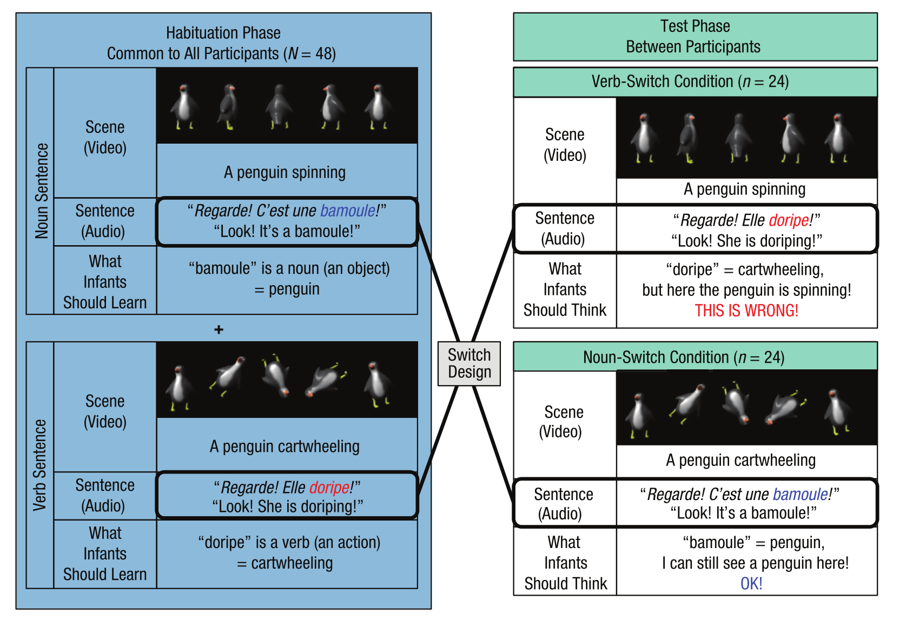

Slide 10
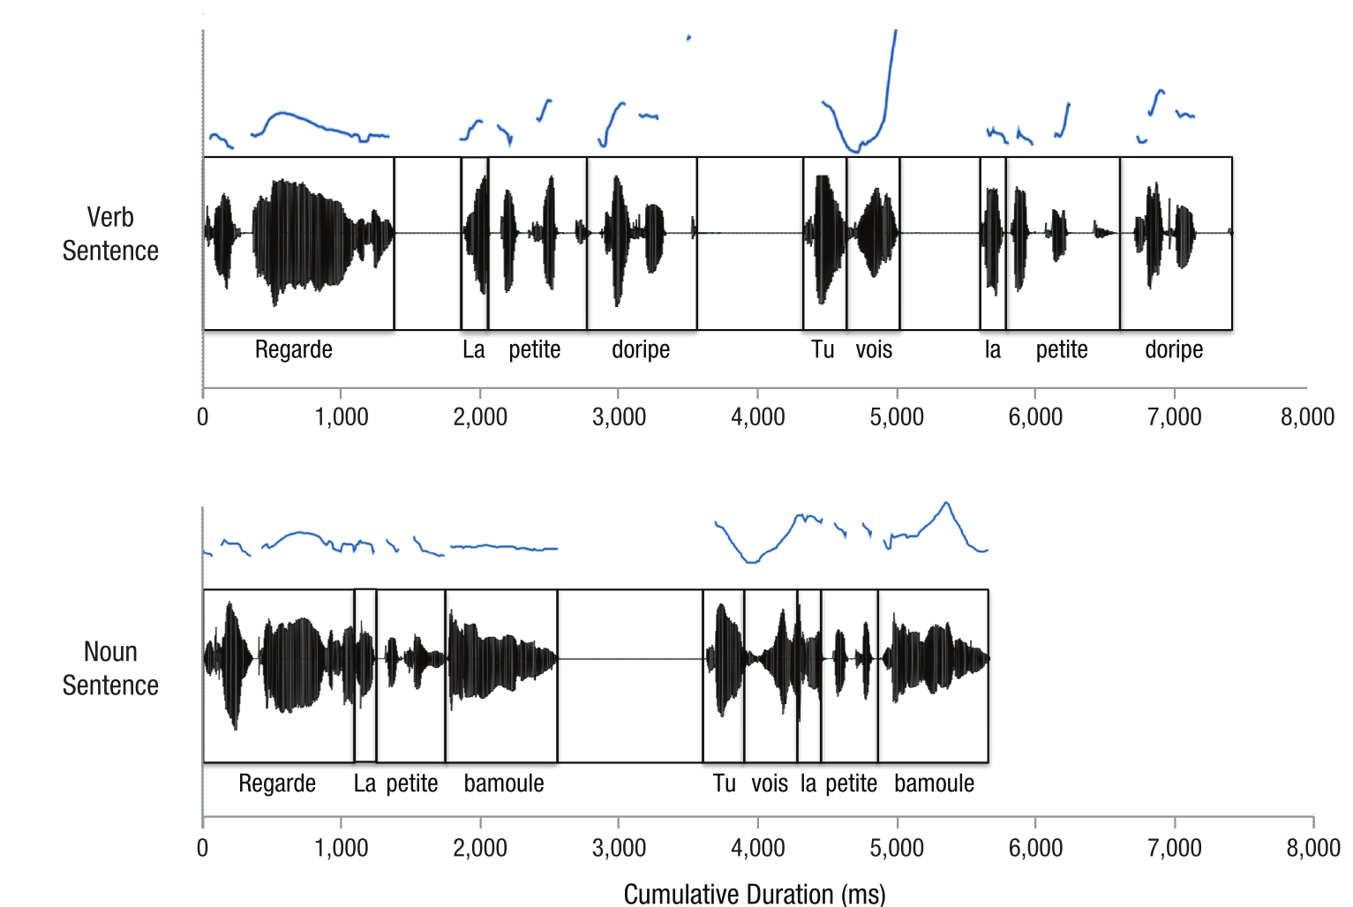
Experimental Design
[Look]! [The little one] [is doripe]! [Do you see]? [The little one] [is doripe]!
[Look at the little bamoule]!
[Do you see the little bamoule]?

Slide 11
Part 3
Reproduction

Slide 12
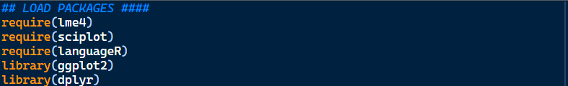
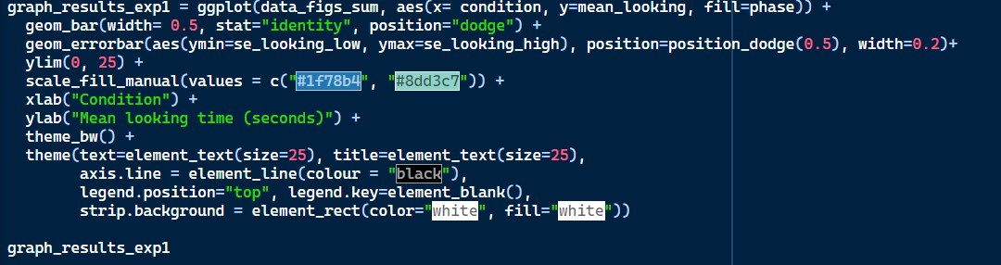
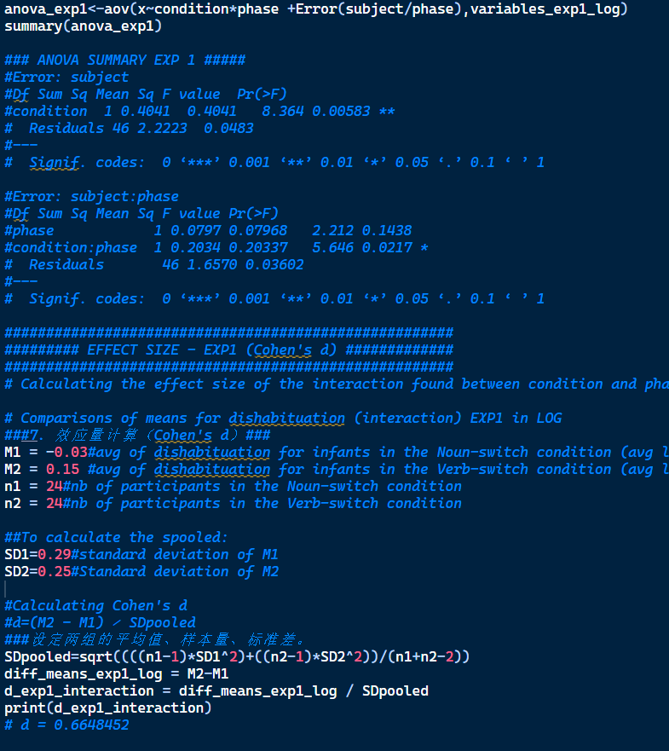
Inferential Statistics
Original Research

Slide 13
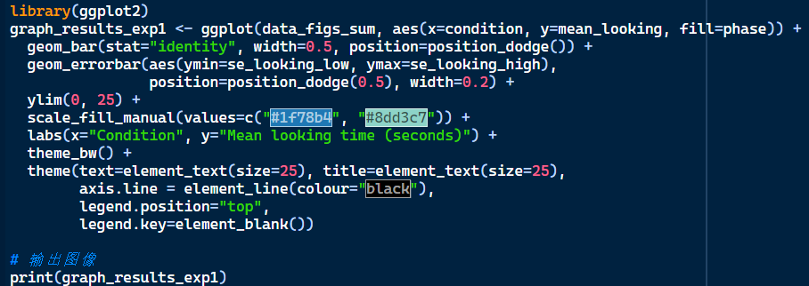
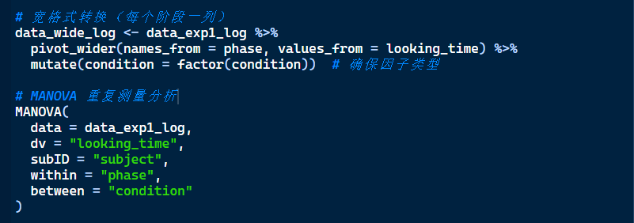
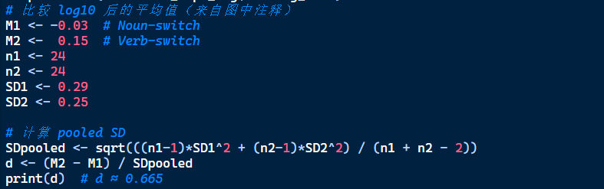
Inferential Statistics
Reproduction

Slide 14
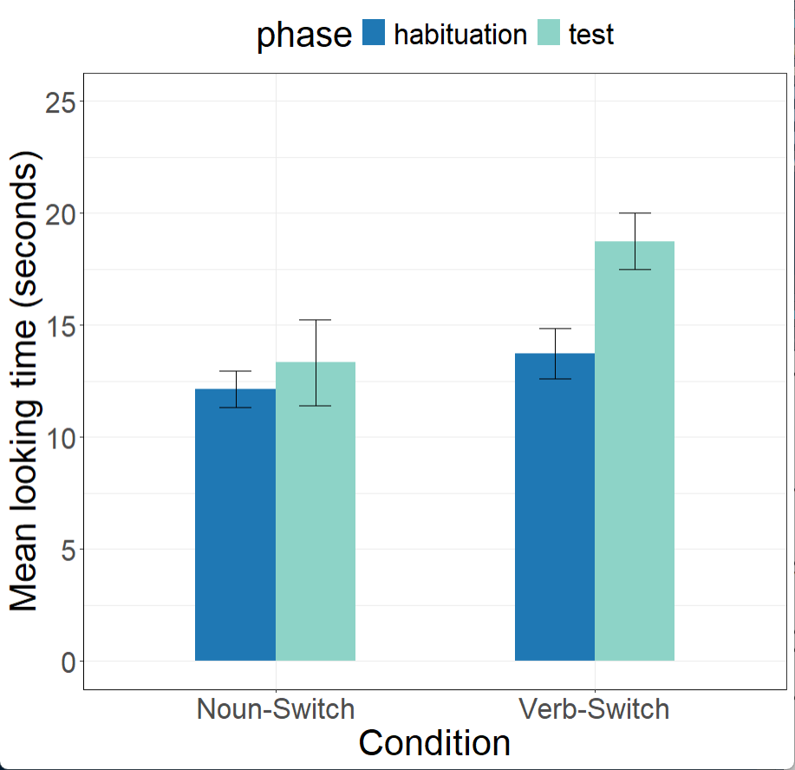

Inferential Statistics-Experiment 1
Original Research
Reproduction

Slide 15
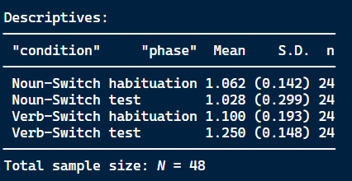
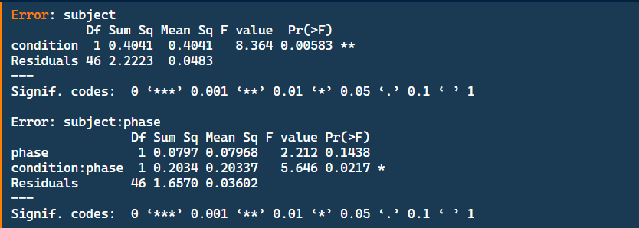
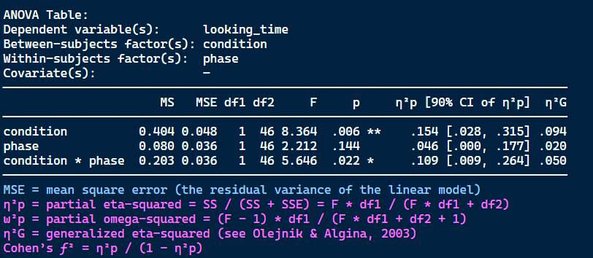
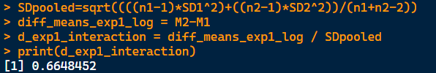
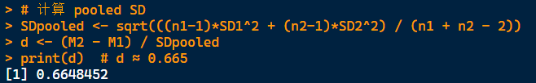
Inferential Statistics-Experiment 1
Original Research
Reproduction

Slide 16
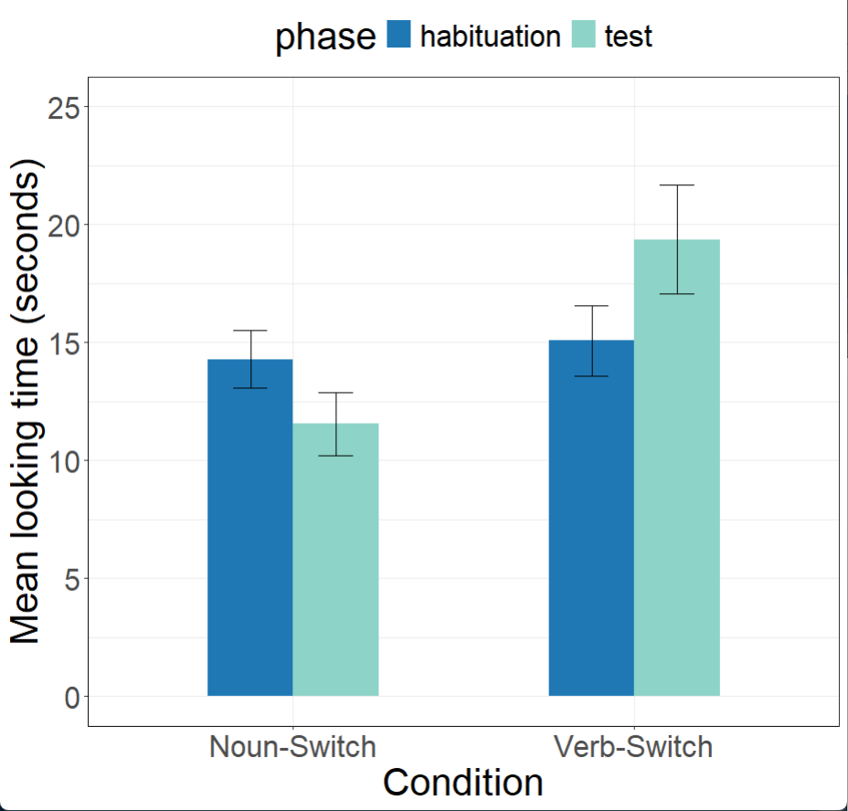

Inferential Statistics-Experiment 2
Original Research
Reproduction

Slide 17
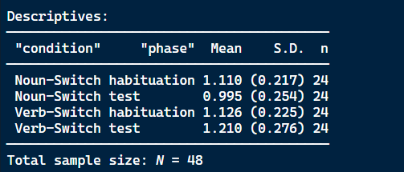
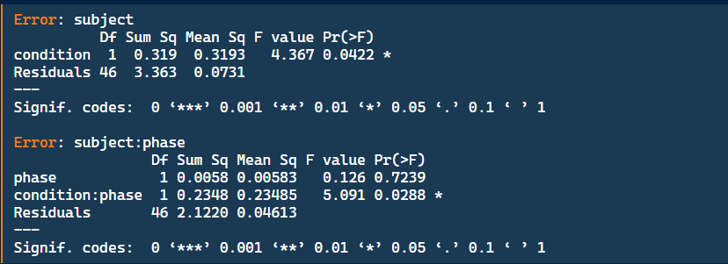
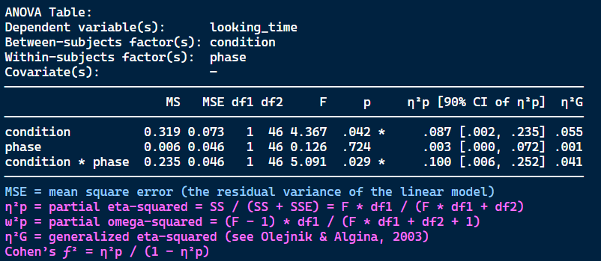
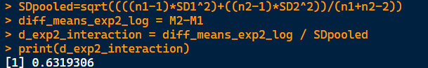
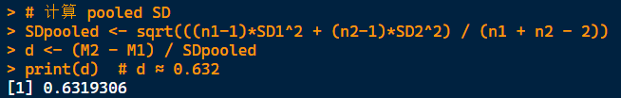
Inferential Statistics-Experiment 2
Original Research
Reproduction

Slide 18
Novel Analytical Approach
Part 4

Slide 19
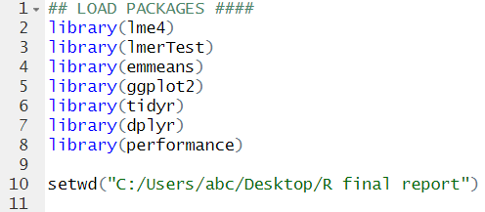
Load Package and Setting Working Directory
Preliminary Preparations：

Slide 20
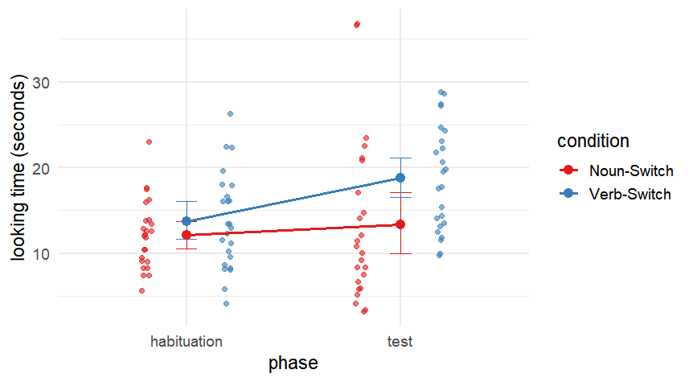
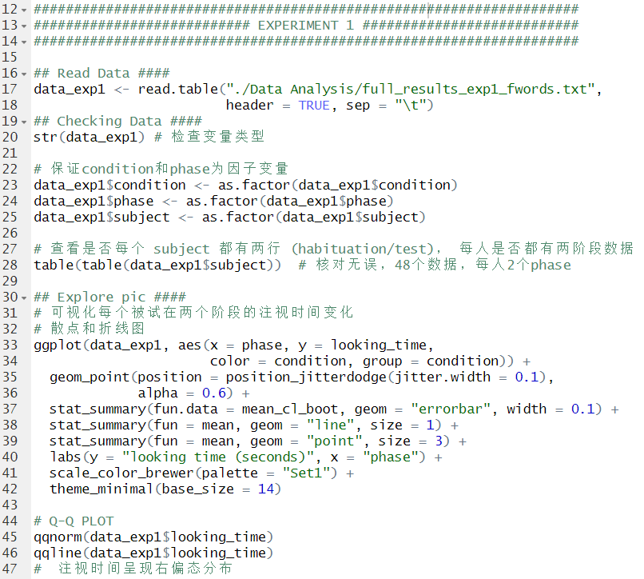
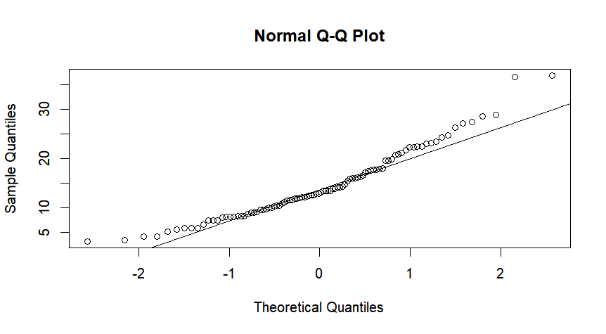
Experiment 1：Data import, preprocessing, and exploratory analysis

Slide 21
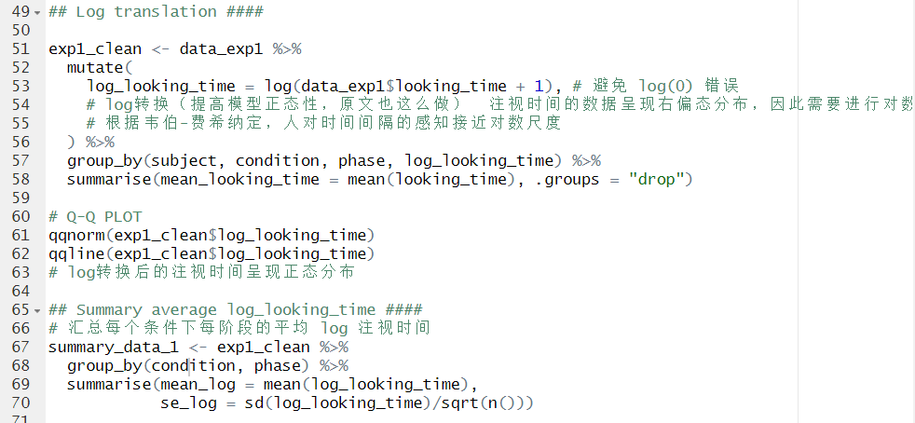
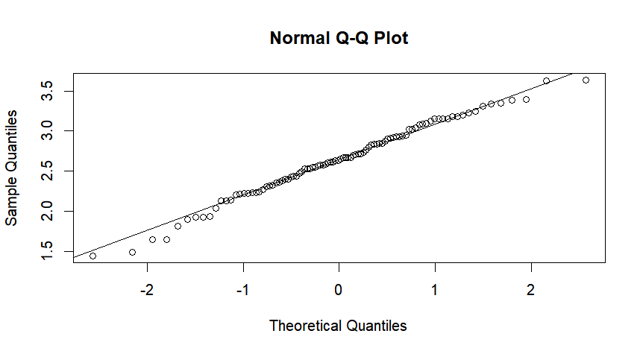
Experiment 1：Data logarithmic conversion and normality testing

Slide 22
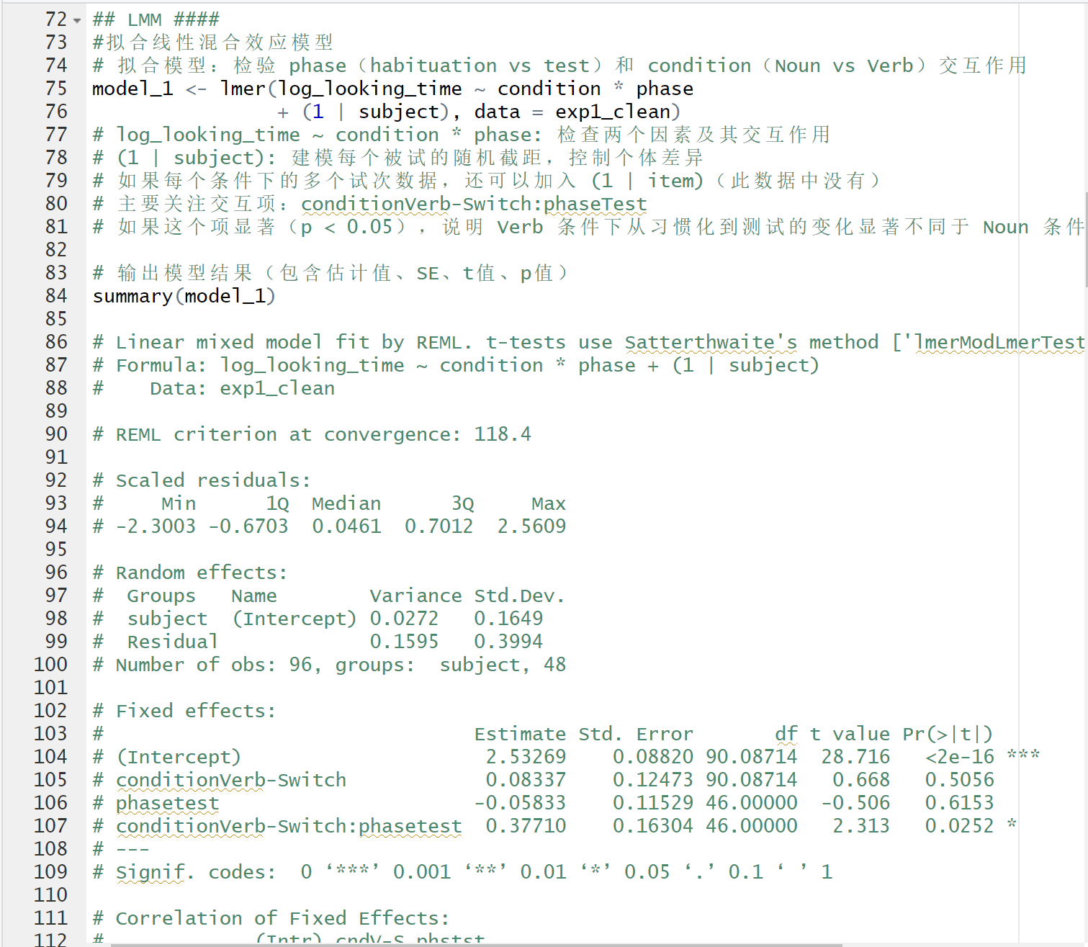
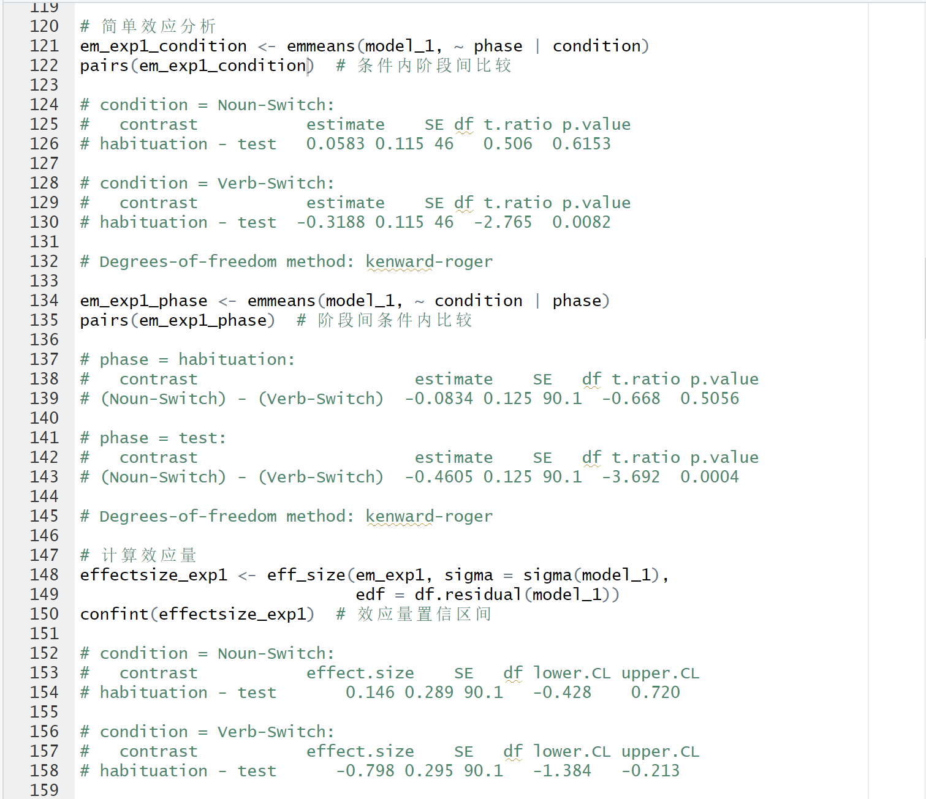
Linear Mixed-Effects Model
Result——Experiment 1
交互作用：Cohen’s d = 0.944>0.665_{original}
Notes:
|d₁ - d₂| = |0.146 - (-0.798)| =0.944
我们使用线性混合效应模型发现了一个显著的交互作用（p = .025），表明婴儿在不同条件下对结构变化的反应不同。
在 Verb-Switch 条件下，婴儿在测试阶段的注视时间显著减少（p = .008，d = –0.80），显示他们对结构变化产生了反应。
在 Noun-Switch 条件下，注视时间没有显著变化（p = .615，d = 0.15）。
进一步分析发现，在 测试阶段，Verb 条件的婴儿注视时间明显长于 Noun 条件（p = .0004），而在习惯化阶段两者没有差异（p = .506）。
In Experiment 1, we found a significant interaction between condition and phase (p = .025), indicating that infants responded differently depending on the cue type.
In the Verb-Switch condition, infants' looking time decreased significantly from habituation to test (p = .008, d = –0.80), suggesting structure sensitivity.
In the Noun-Switch condition, there was no significant change (p = .615, d = 0.15).
At the test phase, infants in the Verb condition looked significantly more than those in the Noun condition (p = .0004), with no difference during habituation.

Slide 23
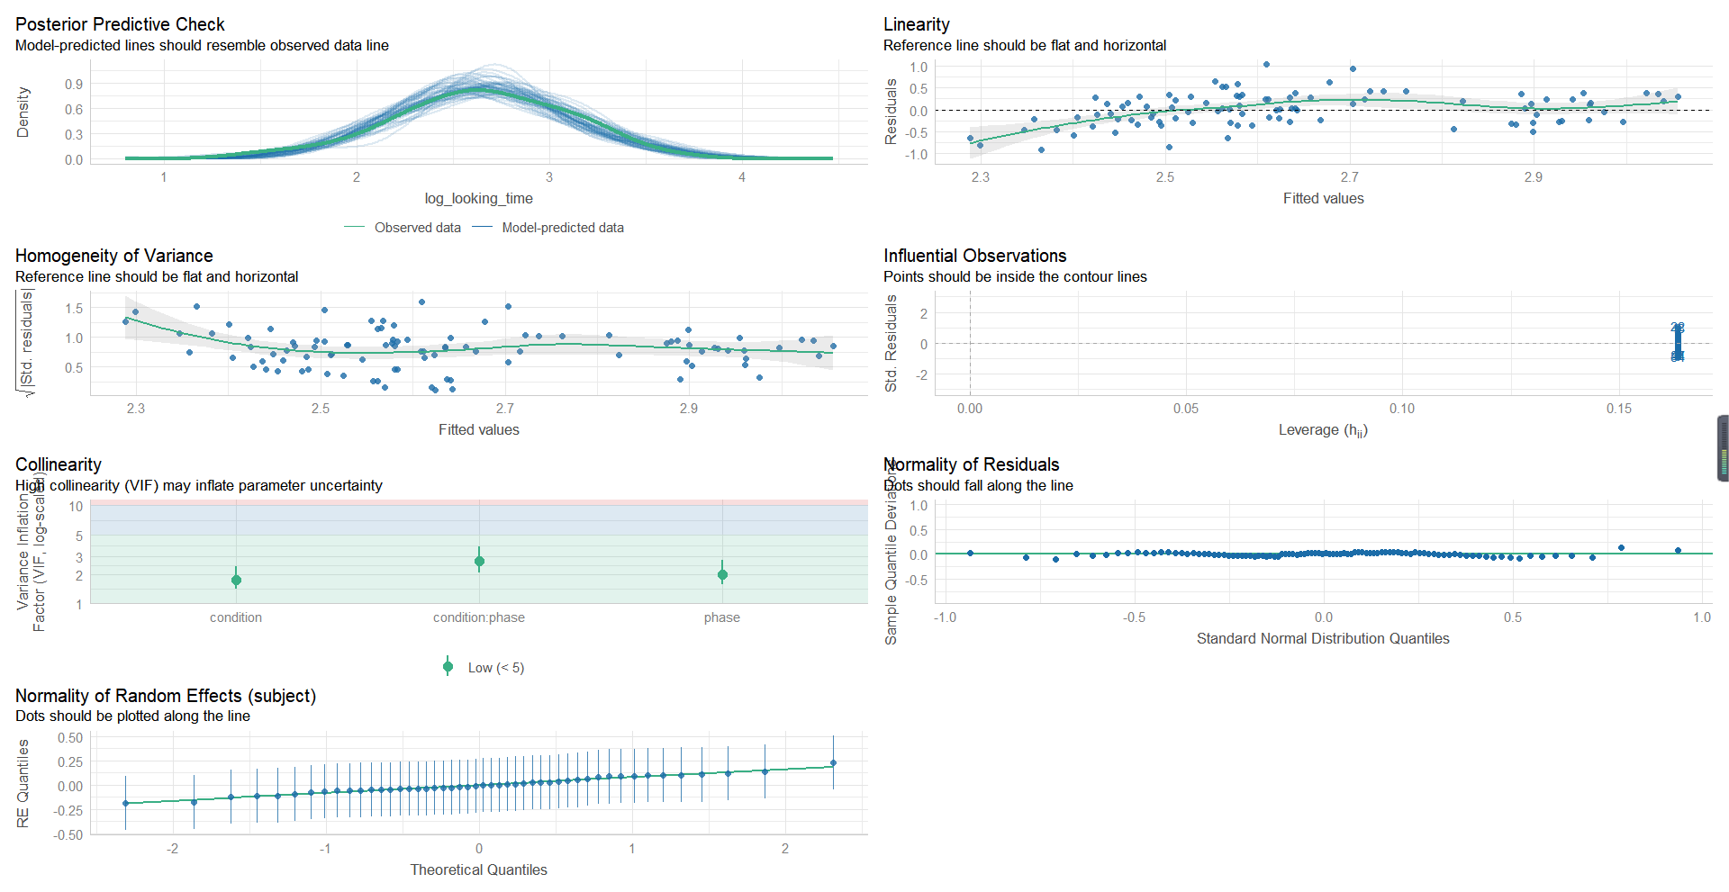
Check_Model(Model_1)
Result——Experiment 1

Slide 24
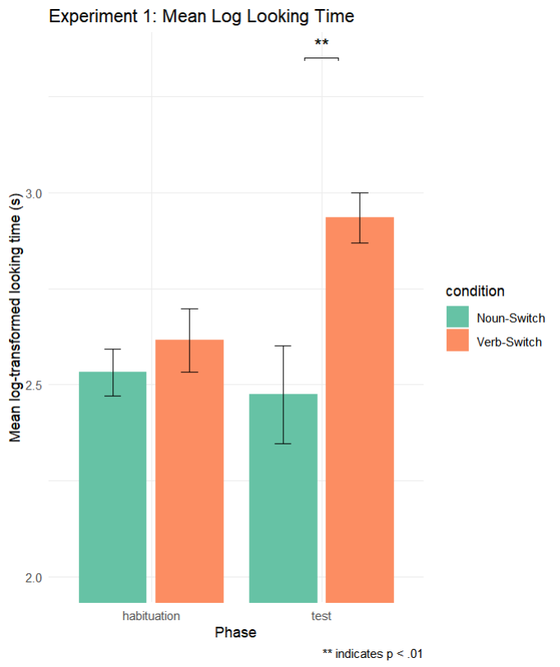
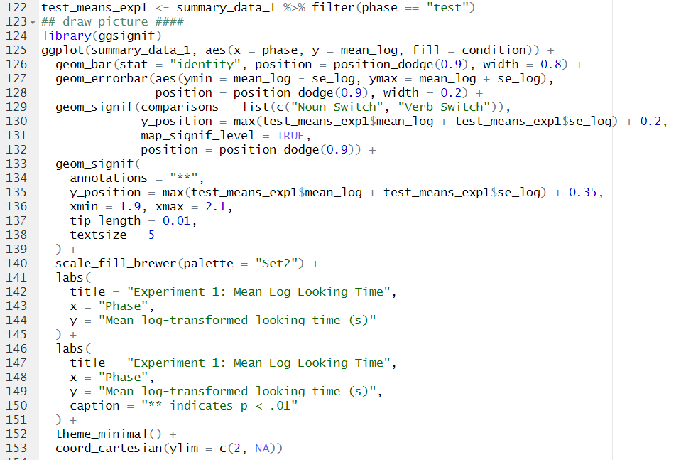
Data Visualization
Result——Experiment 1

Slide 25
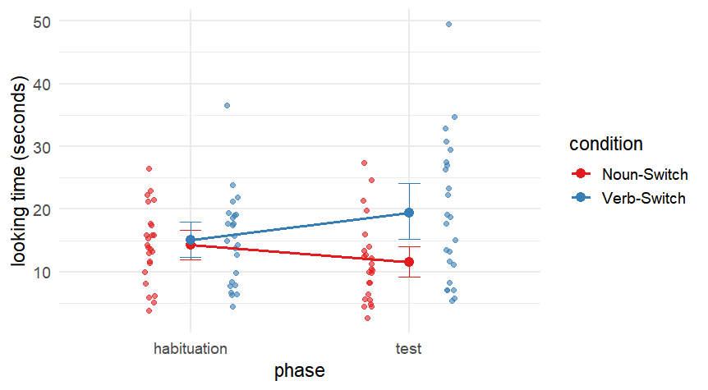
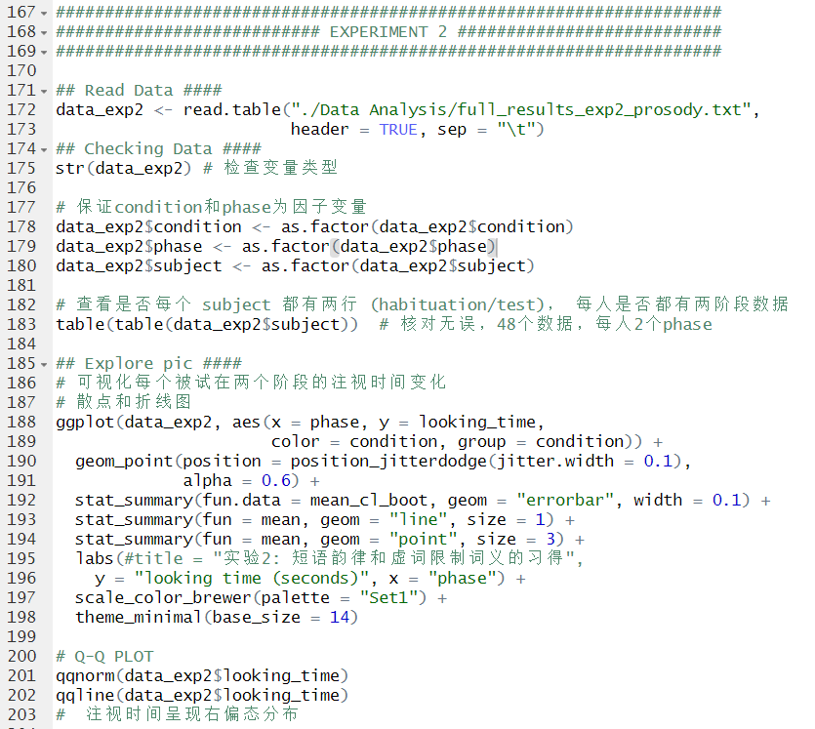
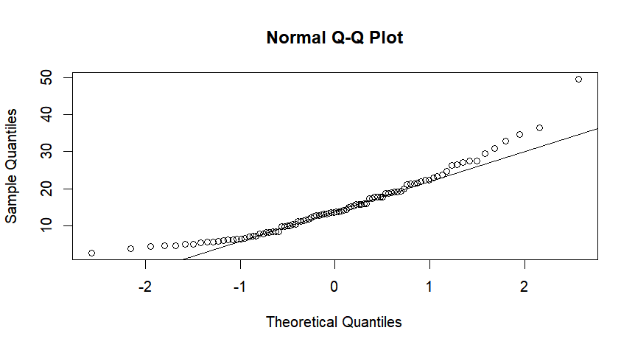
Experiment 2：Data import, preprocessing, and exploratory analysis

Slide 26
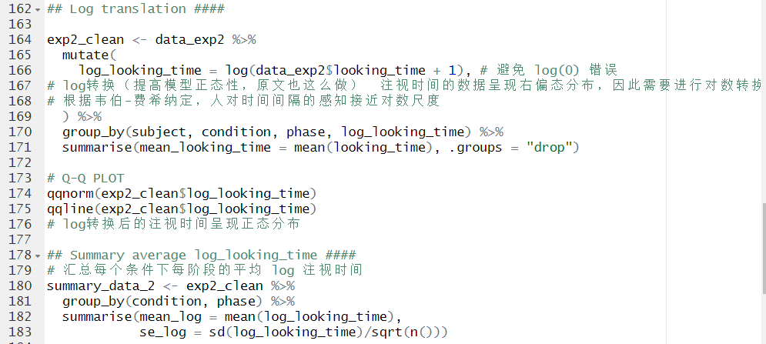
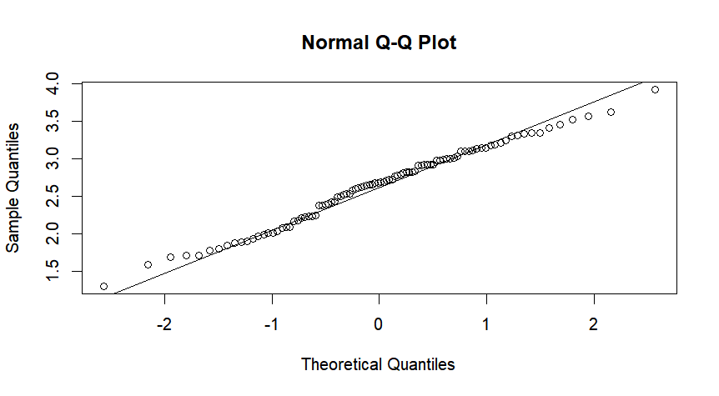
Experiment 2：Data logarithmic conversion and normality testing

Slide 27
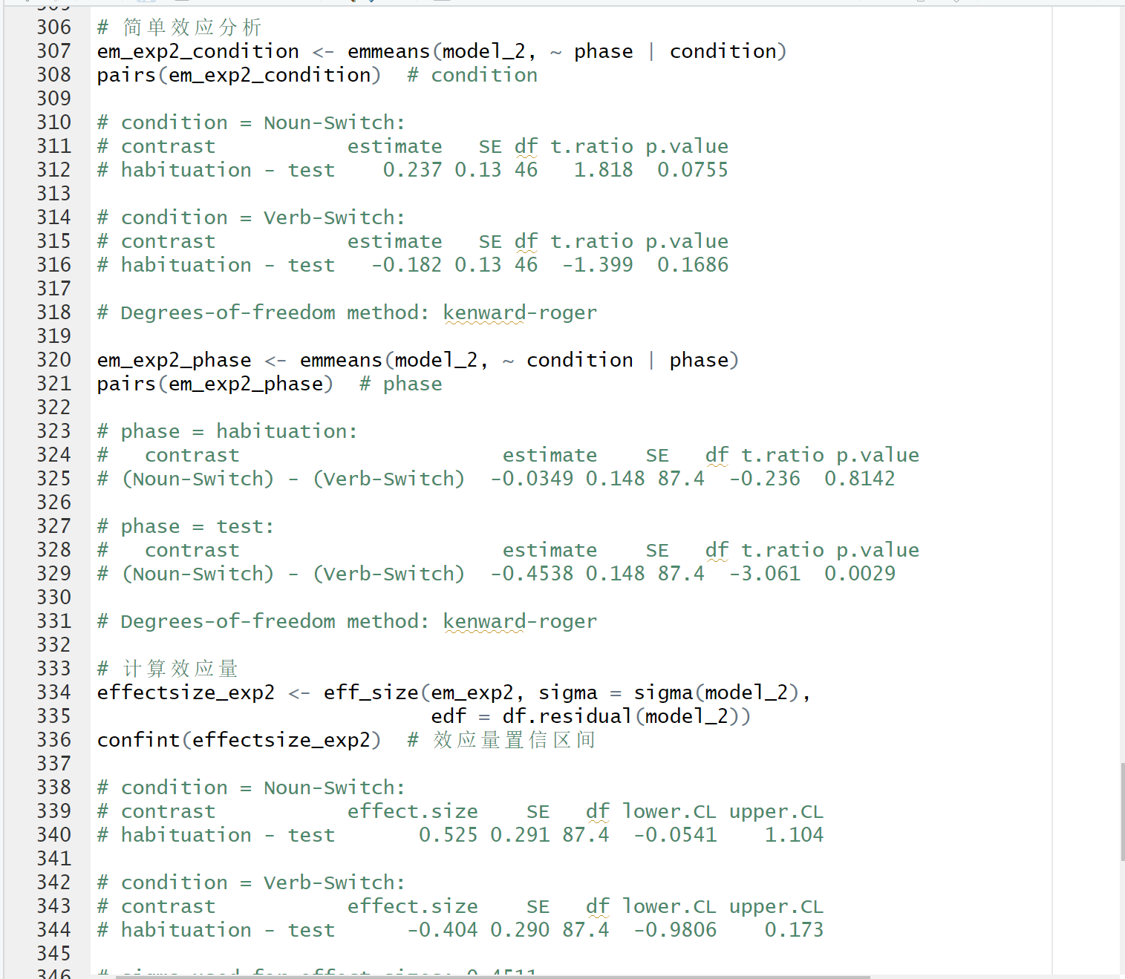
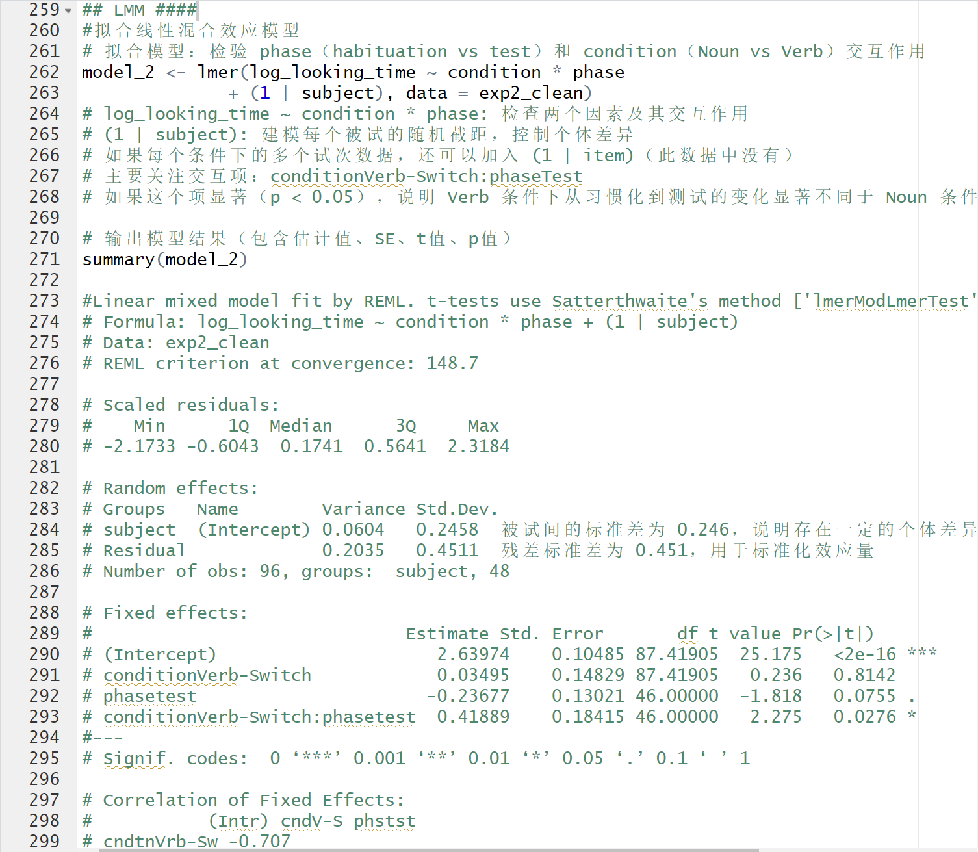
Linear Mixed-Effects Model
Result——Experiment 2
交互作用：Cohen’s d = 0.929>0.632_{original}
Notes:
|d₁ - d₂| = |0.525 - (-0.404)| =0.929
同样地，在实验2中我们也发现了显著的交互作用（p = .028）。
在 Noun-Switch 条件下，婴儿从习惯化到测试阶段注视时间出现边缘显著下降（p = .076，d = 0.53）。
在 Verb-Switch 条件下，注视时间无显著变化（p = .170，d = –0.40）。
在 测试阶段，verb 条件的婴儿注视时间显著高于noun 条件（p = .003），动词转换条件下婴儿的注视时间比名词转换条件下更长
In Experiment 2, we again found a significant interaction between condition and phase (p = .028).
In the Noun-Switch condition, looking time marginally decreased from habituation to test (p = .076, d = 0.53).
In the Verb-Switch condition, no significant change was found (p = .170, d = –0.40).
During the test phase, infants in the Noun condition looked significantly shorter than those in the Verb condition, suggesting that infants feel surprise when verb switching.

Slide 28
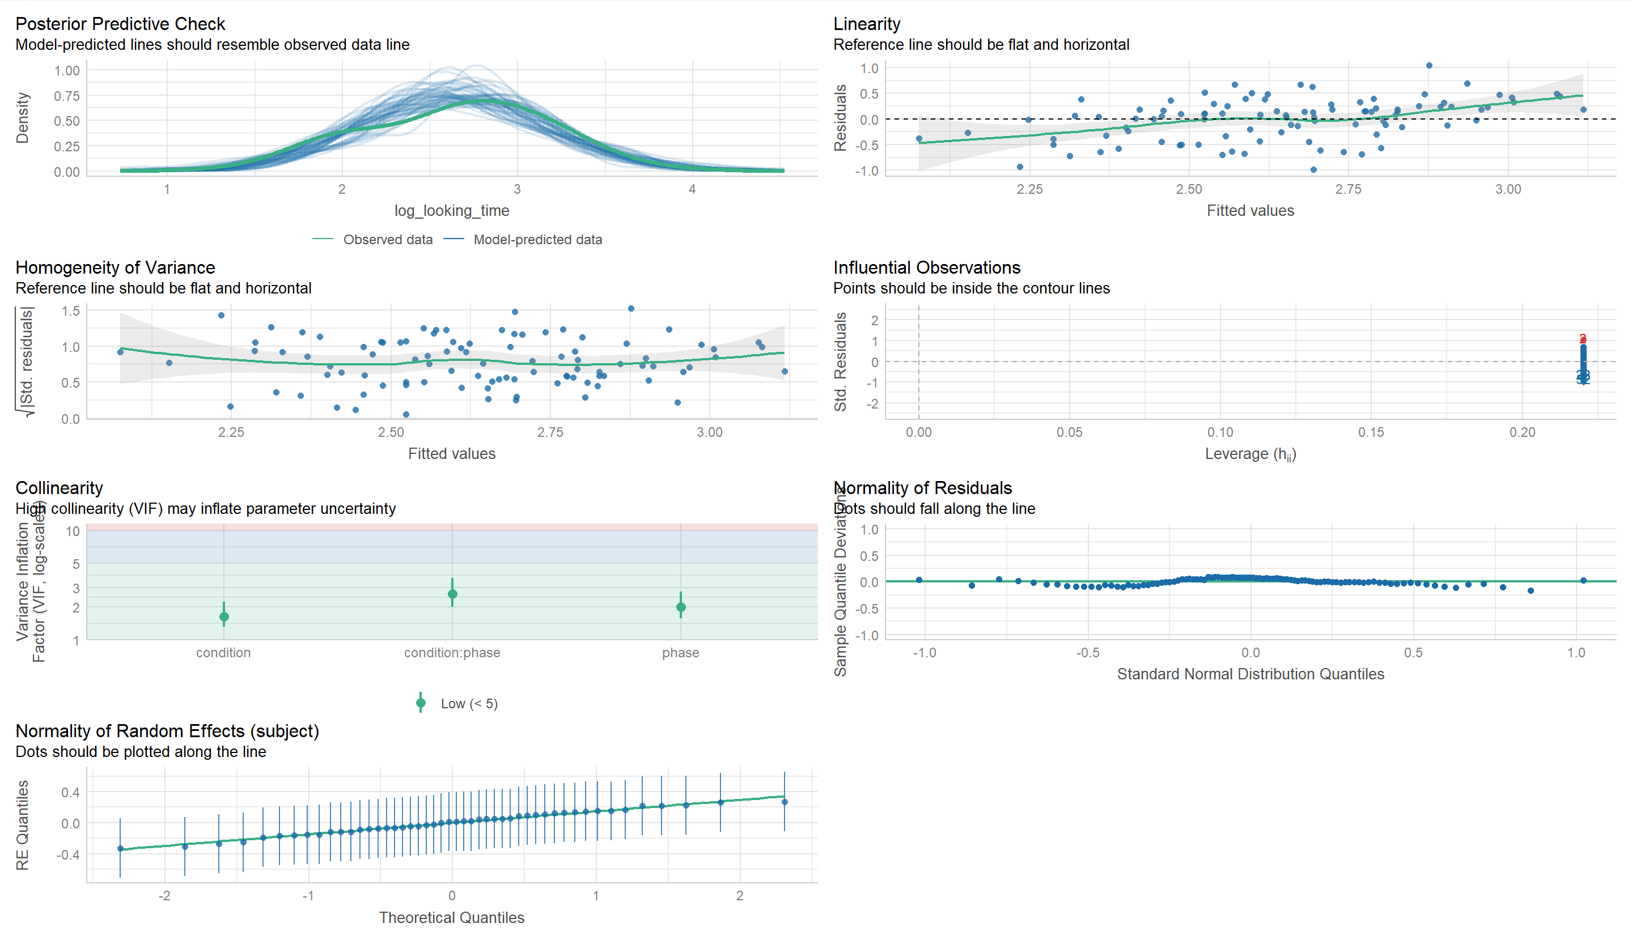
Check_Model(Model_2)
Result——Experiment 2

Slide 29
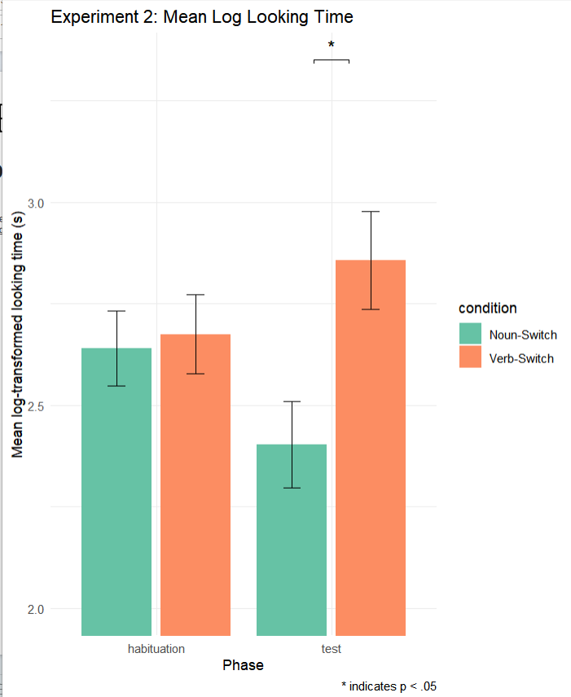
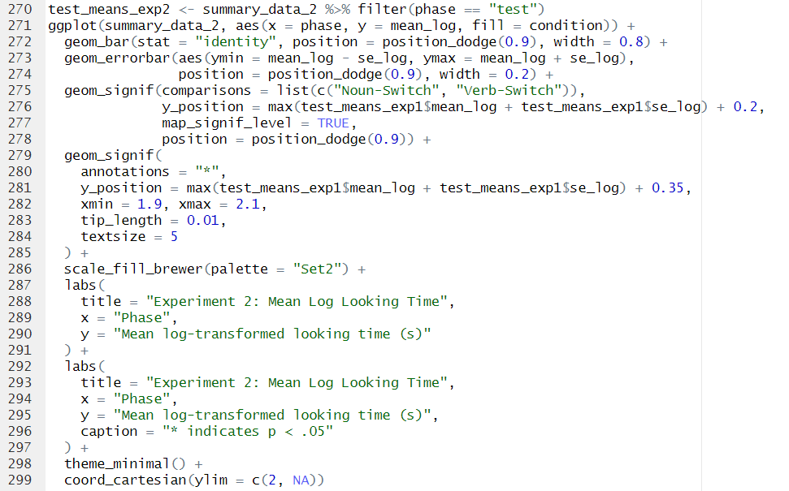
Data Visualization
Result——Experiment 2

Slide 30
Discussion
Part 5

Slide 31
Discussion
表 1 实验一推断性统计结果的比较
表 2 实验二推断性统计结果的比较
 | 样本量N* | 统计量 ( F ) | 效应量 ( Cohen’s d ) | 显著性指标( p )
原文献 报告结果 | 48 | 5.65 | 0.665 | 0.022
本研究 | 48 | 5.65 | 0.665 | 0.022
δ | 0% | 0% | 0% | 0%
评级 | 完全一致 | 完全一致 | 完全一致 | 完全一致
 | 样本量N* | 统计量 ( F ) | 效应量 ( Cohen’s d ) | 显著性指标( p )
原文献 报告结果 | 48 | 5.09 | 0.632 | 0.029
本研究 | 48 | 5.09 | 0.632 | 0.029
δ | 0% | 0% | 0% | 0%
评级 | 完全一致 | 完全一致 | 完全一致 | 完全一致
Notes:
这是我们复现情况的总结表，左图未推断性统计的复现情况，右图为描述统计的复现情况。

Slide 32
Discussion
表 3 结果的计算可复现性的评估表
表 5 推论的一致性的评估表（原分析方法）
结果的可复现性 | 数量及占比
 | N * | %
完全一致(δ = 0%) | 14 | 100
偏差较小(0% < δ < 10%) | 0 | 0
偏差较大(δ ＞ 10%) | 0 | 0
因舍入导致的偏差 | 0 | 0
无法进行可重复检验 | 0 | 0
推论的一致性 | 数量及占比
 | N * | %
一致 | 7 | 100
不一致 | 0 | 0
Notes:
这张图总结了对所有结果计算可重复性的评估。展开讲。

Slide 33
Discussion
表 4 推断性统计结果（创新方法）
表6 推论的一致性的评估表（创新方法）
 | 样本量N* | 统计量 ( t ) | 效应量 ( Cohen’s d ) | 显著性指标( p ) | β
假设一 | 48 | 2.313 | 0.944 | 0.025 | 0.377
假设二 | 48 | 2.275 | 0.929 | 0.028 | 0.419
推论的一致性 | 数量及占比
 | N * | %
一致 | 7 | 100
不一致 | 0 | 0

Slide 34
Discussion
Analysis of Repeatability Test Results
1. Complete reproduction of results: The study can fully reproduce the results because the authors disclose the cleaned dataset and the complete code.
2. Data source: The study only provided the cleaned dataset, and did not provide the original data.
3. Differences in the reproduction of results: There is a slight difference between the reproduction results and the results in the text, which is mainly due to the difference in retained decimal places.
4. Missing descriptive statistics: This part cannot be reproduced because descriptive statistics are not provided in the article.
5. Novel Analytical Approach: We applied more refined modeling techniques (linear mixed-effects models), which confirmed the robustness and replicability of the original findings.

Slide 35
Conclusion
Part 6

Slide 36
Conclusion
Whether reproducing the original analytical method or using a linear mixed-effects model that better controls for individual differences, the conclusions reached are consistent with the original conclusions: infants in their early stages can acquire syntactic information through the combined use of function words and phrase prosody, laying the foundation for language acquisition.
Notes:
无论是复现原始分析方法，还是使用能更好地控制个体差异线性混合效应模型，得出的结论与原结论一致：婴儿早期能通过功能词和短语韵律共同获取句法信息，为语言习得提供基础。

Slide 37
Thanks for listening!
Group Member (in no particular order) : Jieping Duan (029), Runqi Qian (030)
Mingjie Du (031), Tingting Yang (033)
Reporting Date: 2025.6.18

Slide 38
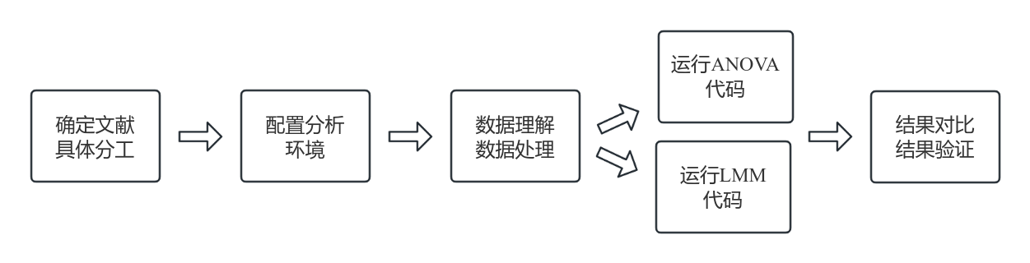
复现思路

